Slide 1
Picture Reveal Game

Slide 2
Directions:
Click on the first square. It will provide a question.
Click the answer that you believe is correct.
After answering correct, the square will disappear revealing a section of the hidden picture.
Continue in order from 1 to 9 until you have answered all of the questions correctly and revealed the hidden picture.

Slide 3
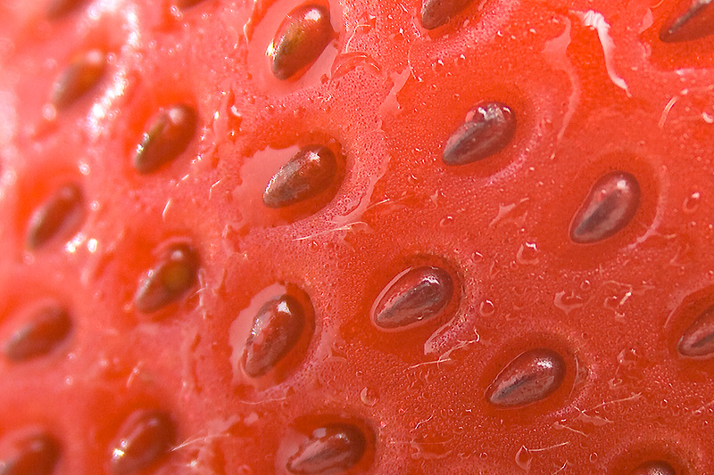
1
2
3
4
5
6
7
8
9

Slide 4
Question 1
Roosevelt overcame of the following except,
.
A. Growing up without enough to eat.
C. Leading the U.S though war.
B. Not being able to walk again.
D.
Leading the U.S through the Great Depression.

Slide 5
Question 2
What was the New Deal?
A way to make the wealthy wealthier.
A.
Plan that led the U.S. into the Great Depression
C.
None of the other choices.
D. Multiple plans that led the U.S out of the Great Depression.
B.

Slide 6
Question 3
During the Great Depression how many people were unemployed at its peak?
A. 55%
C. 25%
B. 45%
D. 35%

Slide 7
Question 4
FDR was president at a time when many people in the country were struggling and he continued to give them hope, because of this he was elected more than any other president in history, how many times was he elected?
A. 3 times
C. 5 times
B. 4 times
D. 6 times

Slide 8
Question 5
What was Franklin D. Roosevelt’s favorite color?
A. Red
C. Yellow
B. Blue
D. Green

Slide 9
Question 6
Which of the following New Deal Acts are still effective today?
A. Social Security Act.
C. Civil Work Administration
B. Tennessee Valley Authority
D. Answer choice A & B

Slide 10
Question 7
FDR talked about the 3 R’s that the country needed, what are they?
A. Relief, recovery. and reform
C. Respect, responsibility, and results
B. Reduce, reuse, and recycle
D. Responsibility, respect, and reverence

Slide 11
Question 8
What was Fala’s full name?
A. Falahill
C. Murray the Outlaw of Falahill
B. Falalala
D. Fala Roosevelt

Slide 12
Question 9
What coin is Franklin D. Roosevelt on?
A. Quarter
C. Penny
B. Nickel
D. Dime

Slide 13
2
3
4
5
6
7
8
9

Slide 14
3
4
5
6
7
8
9

Slide 15
4
5
6
7
8
9

Slide 16
5
6
7
8
9

Slide 17
6
7
8
9

Slide 18
7
8
9

Slide 19
8
9

Slide 20
9

Slide 21
Can you guess what this is a
picture of??

Slide 22
